Slide 1
Beazley
Jira Ways of Working for GPAS & Billing Programme Delivery
Drafted: Apr-2024

Slide 2
The Jira Ways of Working depicted here is the proposed setup of all Capgemini owned work within GPAS & Billing components. This proposal will be fed into overall programme Jira ways of working.
Please read this document in conjunction with the Ways of Working document.
Please note that Jira’s Way of Working document is –
  Guidance on how the Jira process is expected to run
  Teams are encouraged to suggest improvements

Slide 3
Table of Content
Jira Setup Overview
Jira Setup – Naming Convention
Jira Setup – One Scheme configuration
Jira Structure of a project
Jira Xray traceability view
Jira Workflow (Story, In sprint Defect, Stabilisation)
Linked issues
Jira Dashboards & Reports
Tracking of Sprint Start & Closure
Appendix
  Sprint Preparation
  Project Configuration
  Jira Issue Creation

Slide 4
Jira Setup - Overview
Project Name: Beazley GPAS & Billing Program
Policy Project
Story 1
Sprint 1
Initiative
Story 2
Story 1
Story 3
Sprint 2
Epic -1
Story 2
Story 4
Sprint N
Story 5
Story 3
Billing Project
Story 4
Story 10
Story 5
Story 5
Sprint 1
Epic -2
Story 6
Story 6
Sprint 2
Story 3
Story 7
Story 7
Sprint N
Story 12
Story 8
Story 8
Epic -3
Story 9
Integration Project
Story 10
Story 9
Sprint 1
Story 7
Story 11
Story 10
Sprint 2
Story 9
Story 12
Story 11
Sprint N
Story 12
*Features will be tracked as part of components field

Slide 5
Jira Setup – Naming Convention
Projects | Issue Key | Board
GPAS & BC Scrum of Scrums | BZSOS | Kanban
BZ PolicyCenter | BZPC | Scrum
BZ BillingCenter | BZBC | Scrum
BZ Integration | BZINT | Scrum
BZ Data | BZD | Scrum
BZ Migration | BZM | Scrum
BZ Documents | BZDOC | Scrum
BZ Architecture | BZA | Scrum
BZ Product Rationalization | BZPR | Scrum
BZ System Integration Testing | BZSIT | Scrum
BZ User Acceptance Testing | BZUAT | Scrum
BZ Production | BZP | Scrum
Projects are not yet created in Jira

Slide 6
Jira Setup – One scheme configuration
GPAS & Billing Projects*
Screen Scheme
Workflow Scheme
Issue type Scheme
Permission Scheme
Screen scheme – Where fields will be added to the screens (create, edit & view) and configured to the issue types
Workflow Scheme – Workflow will be created and configured to the issue types
Issuetype scheme – Defines which issue types are applicable for the project and configured to the project
Permissions scheme – Define what permission can be granted to user, roles or group in a project
*Policy, Billing, Integration Projects

Slide 7
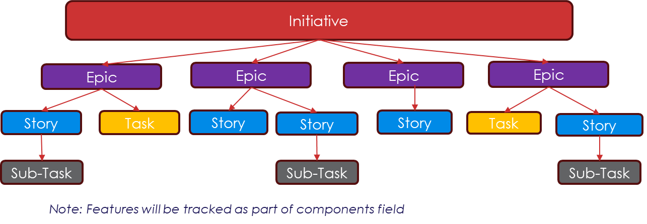



Jira Structure of a project
Project
(Workstream)
BZ PolicyCenter
Scrum board 1
BZFoundation R1
Scrum board 2
BZPolicyCenter R2
Scrum board 3
BZPolicyCenter R3
Project
(Workstream)
BZ Billing
Scrum board 1
BZFoundation R1
Scrum board 2
BZBilling R2
Scrum board 3
BZ Billing R3
Scrum Board
Release Backlog
Sprint Backlog
Sprint board (Active Sprint)
Reports

Slide 8
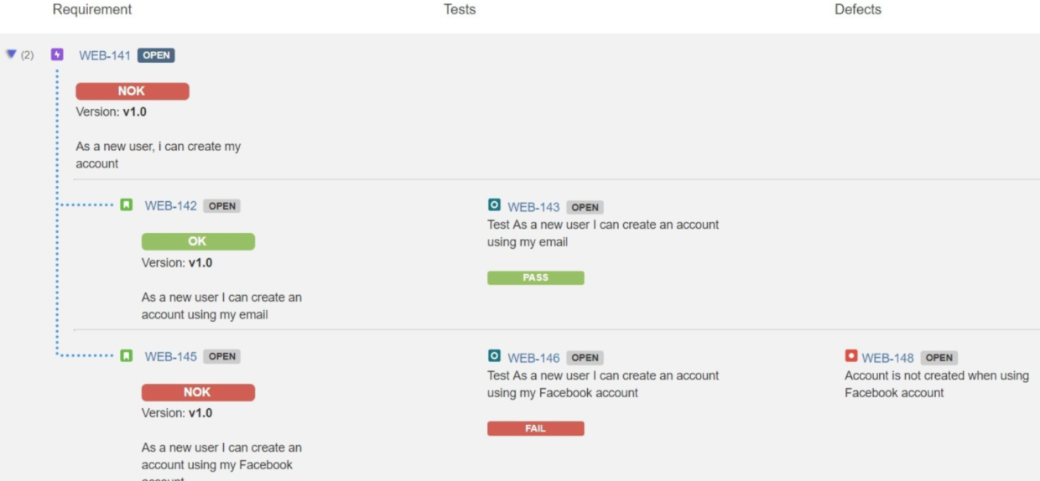
Jira Xray Traceability view
Test Execution 1
Test Plan 1
Test 1
Story 1
Test 2
Business Capability Mapping Document
(Reference & Description)
Epic -1
Story 2
Test 1
Test Set A
Test 7
Story 3
Test 2
Test 3
Epic -2
Development 1
Test 3
Test 4
Epic -3
Story 4
Development 2
Test 4
Test 7
Story 5
Development 3
Test 5
Test Plan 2
Test Execution 2
Epic -4
Story 6
Test 6
Test 3
Test 6
Test 8
Test 3
Epic -5
Story 7
Test 7
Test 6
Story 8
Test 8
Test 8
Epic -N
Story 9
Jira Xray traceability report provides complete view of requirement status from Epic to Defects hierarchy

Slide 9
Jira Setup – User Story Key Fields
Field | Description
Summary | Provides a brief description of the story
Description | Captures the functional requirement, Entry & Exit criteria or any other considerations (Integration, Data migration or non-functional/performance information
BCM Reference | Provides capability references from Funmat for which this story is implemented
BCM Description | Provides capability description from Funmat for which this story is implemented
Acceptance Criteria | Captures the Acceptance criteria for the story
Fix Version(s) | Provides the release version in which story is deployed
Sprint | Provides in which story is build
Story Points | Units of measure for expressing an estimate of the overall effort required to fully implement a story
Components | Used to group issues (Feature tagging)
Business Priority | Helps users determine which issues should be tackled first
Parent | A relational link to determine an issue’s parent epic
Linked issues | Helps to identify the Dependent issues, Defects, Tests other related issues to this story
Dev Due Date | Provides info when the dev & Unit testing for the story will be completed & testing activities can be planned
Due Date | Provides info when testing execution will be completed & Demo can be planned with Business
Note: Highlighted fields are new custom fields to created (Service request ID – RITM1135026)

Slide 10
Jira User Story workflow
Product Backlog
All
To Do
Deferred
All
All
Blocked
In Refinement
Archived
All
Refinement Complete
Ready for Design
Ready for Development
In Code Review
In Development
Development Blocked
Ready for Test
In Testing
Testing Blocked
Ready for Showcase
Done
Service Ticket ID: RITM1137241

Slide 11
Jira Initiative & Epic workflow
To Do
All
In Refinement
Refinement Complete
In Progress
Auto change to done when all linked issues are moved to done
Done

Slide 12
Jira Insprint Defect Workflows
New
On Hold
All
All
Deferred
All
Open
Reopen
Rejected
All
Fixed
Duplicate
All
Ready for Testing
In Testing
Closed

Slide 13
Jira Stabilization workflow -- Draft
All
Deferred
Open
Duplicate
All
All
Rejected
Assigned
All
Reopened
Development
Development Blocked
Fixed Locally
Ready for E2E Promotion
In E2E Testing
In E2E Testing
Testing Blocked
Ready for UAT Promotion
In UAT Testing
Closed UAT – Ready for Deployment
Closed

Slide 14
Jira SOS Project – Task workflow
Backlog
All
Potential Blocker
All
Blocker
All
Open Actions
All
In Progress
All
Complete
All
Done
All
Service Ticket ID: RITM1137214

Slide 15
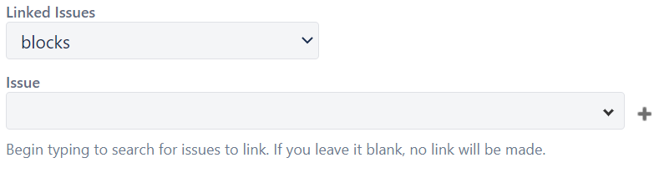
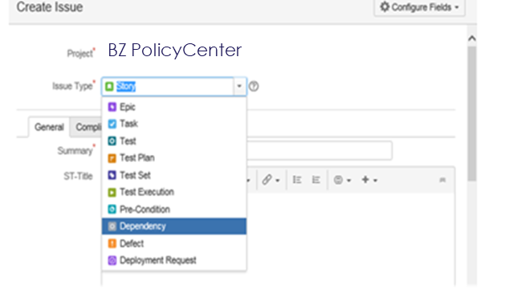
How Dependencies are handled
Linked Issues field signifies the relation of stories with
  Tests (tested by)
  Blockers (blocks/is blocked by)
  Dependent (Depends on)
Few other options good have in Beazley Jira instance are -
  has to be done before
  has to be done after
  Must be delivered in parallel
  Is delivered in parallel
Dependent issue will be created for the stories that doesn’t exist in Jira and then link it to the story.

Slide 16
Dashboard & Reports

Slide 17
Jira Dashboards for reporting
Dashboard Category | Dashboard Views
Workstream Backlog | Workstream backlog, Release backlog, Sprint(s) Backlog, Issues not tagged to Release or Sprint Backlog
Individual Sprint | Days Remaining, Sprint Progress, Story points planned, Stories vs status stats, Blocked stories view, Defect stats (different views) & burndown chart
Cross Release Workstream | Days Remaining, Story Points planned, Story points completed, Overall stories (workstreams) vs Status view, Blocked stories view, Defects (Work steams vs status) view, Outstanding issues (confluence page view)
Testing | Overall test (workstream vs test run) view, Defects vs status view, Defect priority vs status, Defect severity vs status.

Slide 18
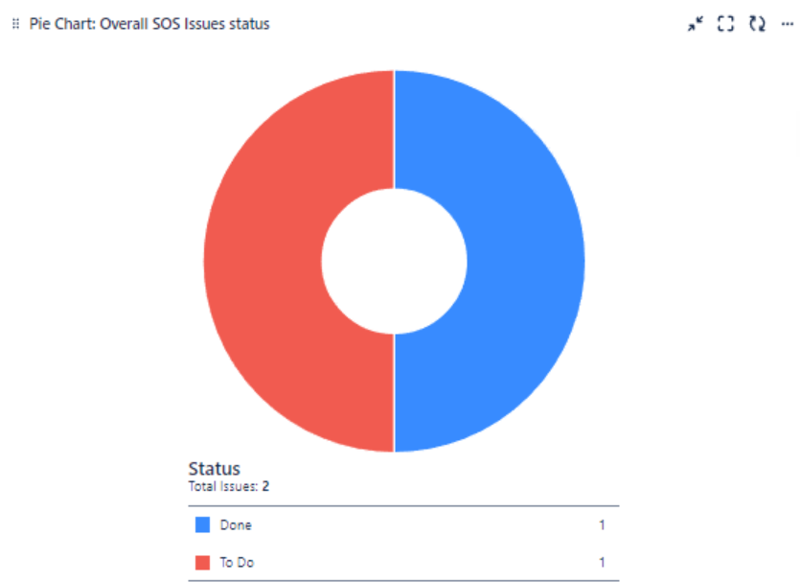
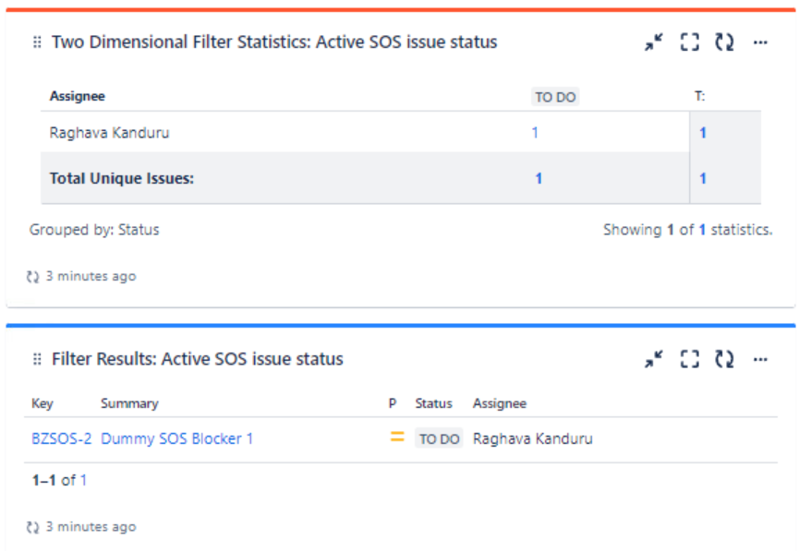
Jira Scrum of Scrums Dashboard (Sample)

Slide 19
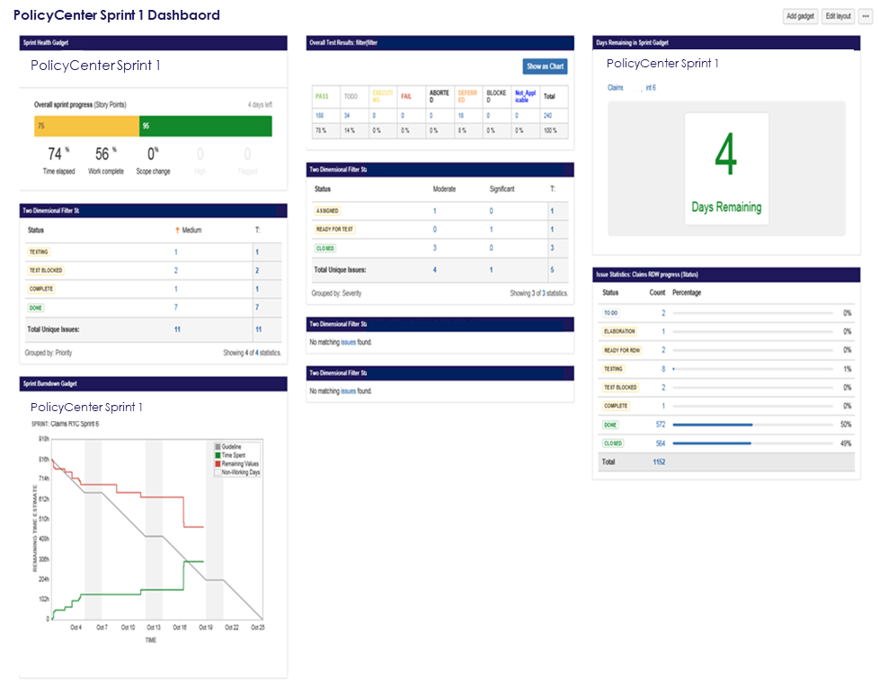
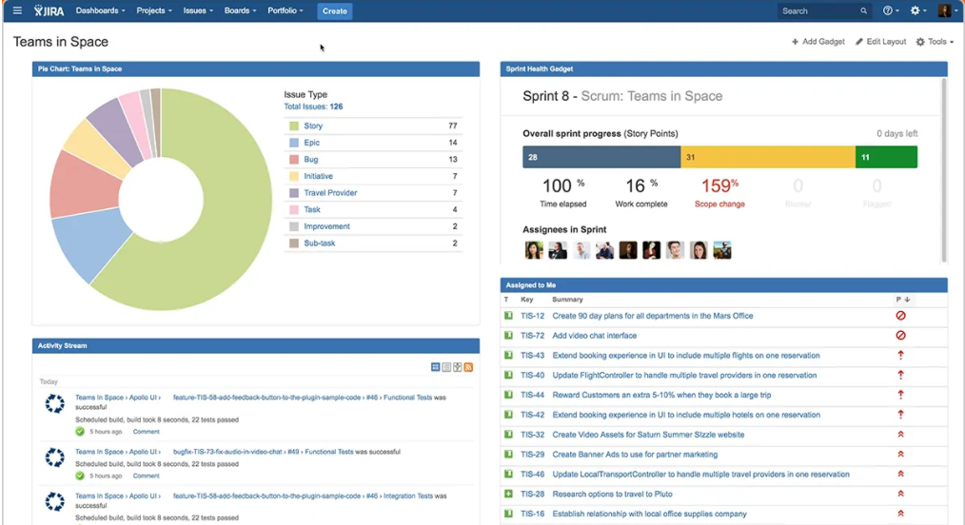
Jira Dashboard (Sample)
Dashboard are a way to present a customized view of projects. They can be created for individual use or to share with others on the team. Dashboard are made up of one or more gadgets. A gadget displays some aspect of the work of the projects.
Sprint Dashoard Views:
Total number of days remaining in the sprint
Overall Sprint progress (% of work completed & Scope change
Stories vs status stats
Test Execution status
Overall Defects vs Priority/Severity stats
Sprint burndown chart

Slide 20
Jira Reporting
The following default charts/reports are available in Jira to track the progress. Sample view of chart and reports are shown in next slides
Category | Description | Frequency
Sprint Report | Shows the work completed or pushed back to the backlog in each sprint | End of each Sprint
Velocity Chart | Tracks the amount of work completed from sprint to sprint | End of each Sprint
Burndown Chart | Tracks the total work remaining, and projects the likelihood of achieving the sprint goal | Daily (during active sprint)
Epic Burndown | Tracks the projected number of sprints required to complete the epic. | End of each Sprint
Release Burndown | Tracks the projected release date for a version. This helps you monitor whether the version will release on time, so you can act if work is falling behind | End of each Sprint
Epic Report | Shows the progress towards completing an epic over time | End of each Sprint (or as needed)
Sprint Report, Velocity chart & burndown chart are most commonly used

Slide 21
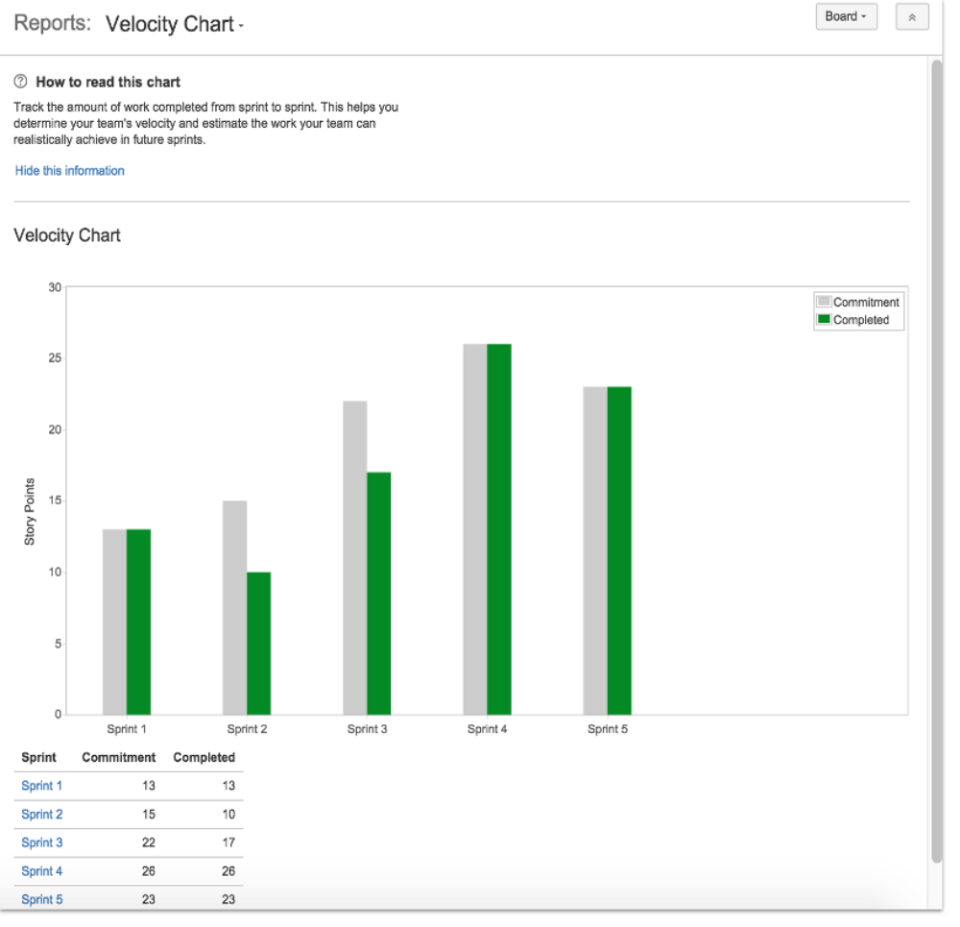
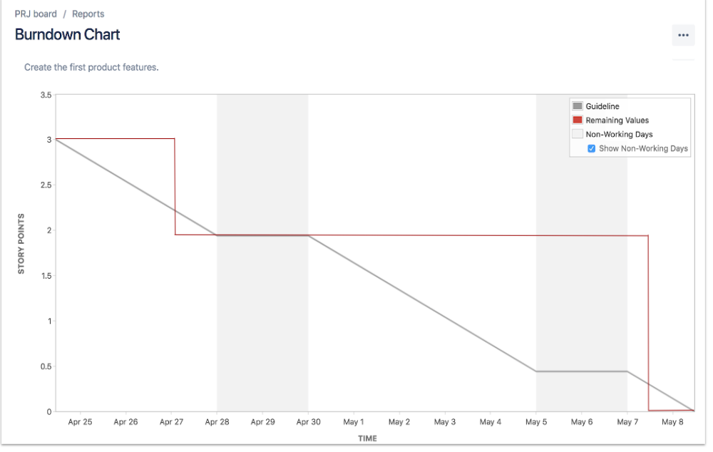
Burndown & Velocity Report (Sample)
A burndown chart show the progress that the makes during a sprint. Chart can be plotted either Story points or Remaining Time estimate (in hrs)
Velocity chart shows the estimated and actual velocity of the team over time

Slide 22
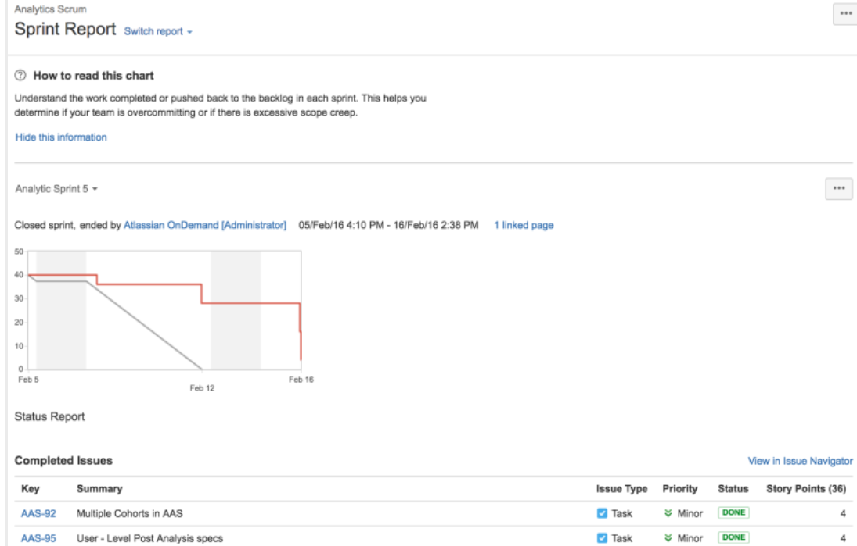
Sprint Report (Sample)
The Sprint Report is board-specific – that is, it will only include issues that match your board's saved filter.
Issues added after the sprint starts are indicated with an asterisk.
An issue is considered to be 'To Do' when it is in a status that has been mapped to the left-most column of your board. Similarly, an issue is considered to be 'Done' when it is in a status that has been mapped to the right-most column of your board.
The grey line is a guideline that's drawn from the total estimate of the issues at the start of the sprint, to 0 at the end of the sprint. The grey line stays flat during non-working days.
The red line represents actual work done during the sprint — it's drawn from the total estimate of the issues at the start of the sprint, and it goes higher or lower as your team works on the issues in the sprint.

Slide 23
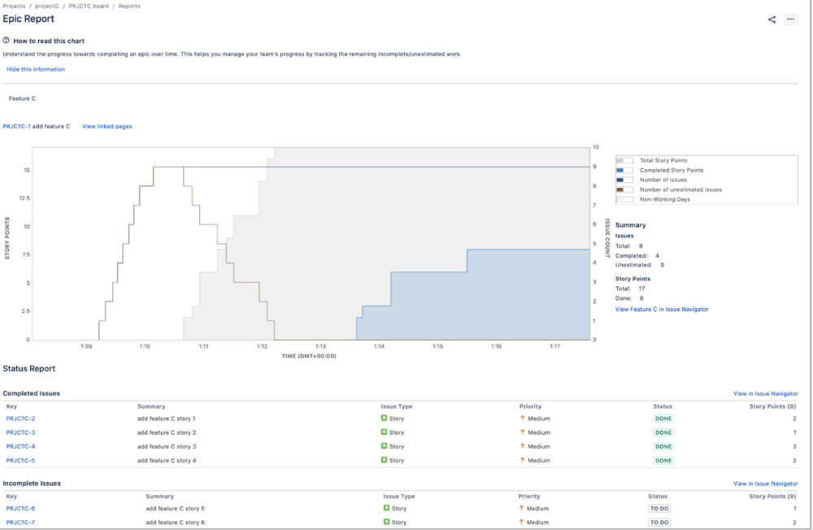
Epic Report (Sample)
This shows the current status of the epic, as well as a list of the issues in the epic. This helps to determine approximately when the epic will be complete.

Slide 24
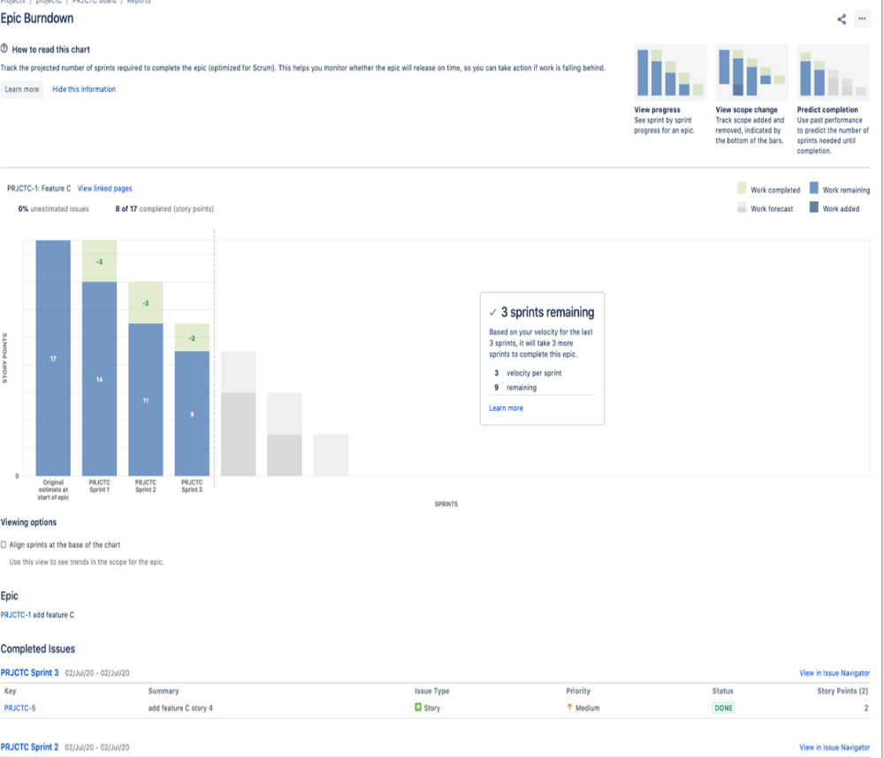
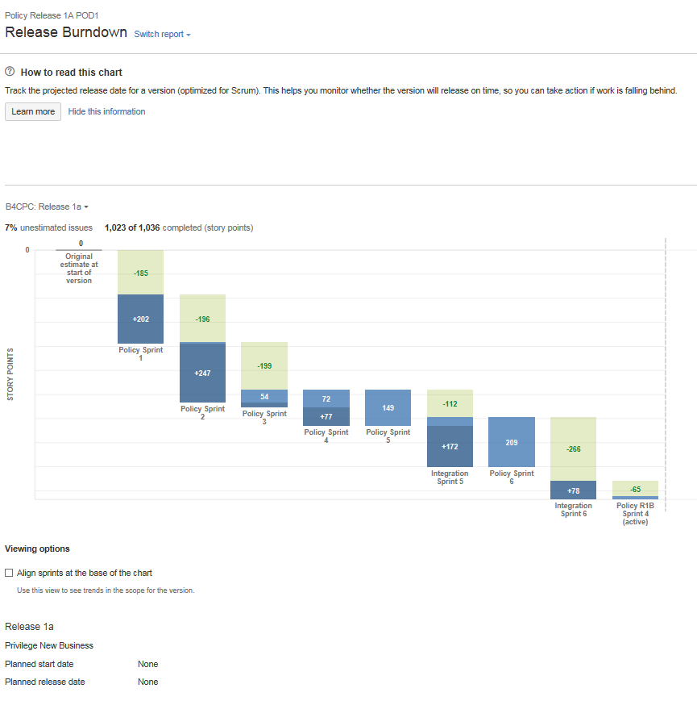
Epic & Release Burndown (Sample)

Slide 25
Tracking of Sprint Start & Closure

Slide 26
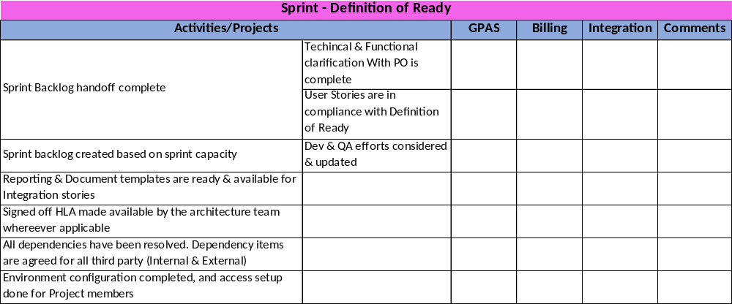
Sprint DOR & DOD
Sprint DOR & DOD checklist will be added to the confluence for each sprint and WS Leads must update the checklist before start & end of the Sprint. This will be reviewed by both the parties and then take a collective decision to start/close the sprint in Jira.

Slide 27
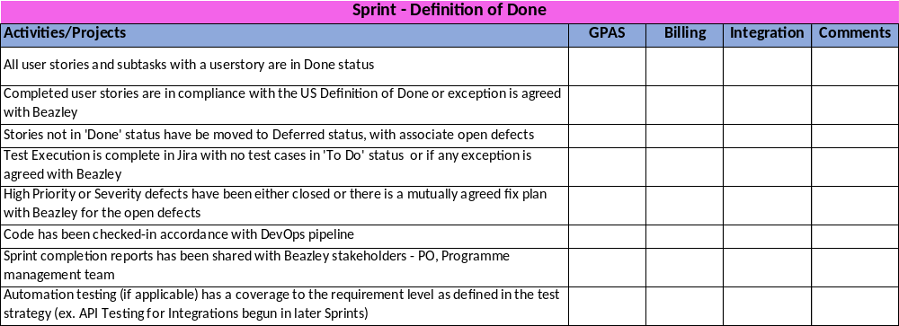
Sprint DOR & DOD

Slide 28
Sprint Closure pack (Proposed)
The Sprint Closure pack will be created & presented to Beazley at end of each sprint. The following areas will be covered as part of the pack –
  Baseline vs Planned vs Delivered Story Points
  Sprint closure stats & Deferred stories data
  Overall active defects
  Release burndown
  DOD, DOR & Retrospective links

Slide 29
Appendix

Slide 30
Sprint Preparation

Slide 31
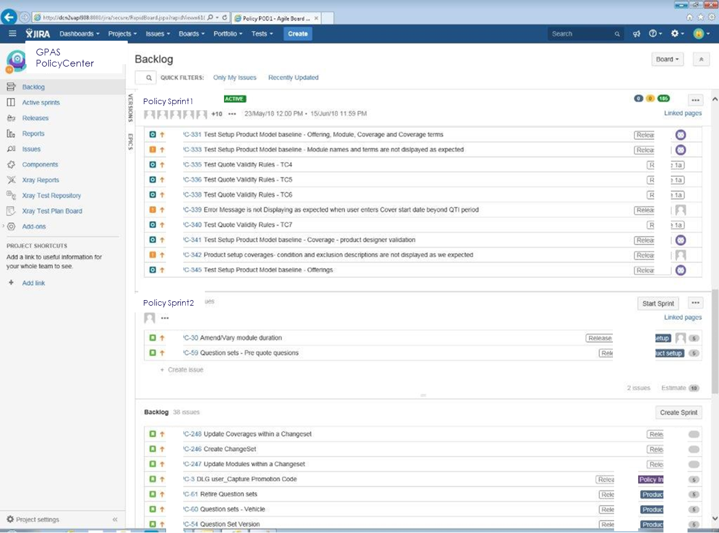
Jira – Backlog Overview
Menu along the left-hand side of the screen allows navigation between the main views in Jira. The most used screens are the Backlog View, Active Sprint View and the Reports Screen.
Backlog view shows a summary view of user stories in the backlog and also those stories that have been assigned to sprints. Only the story summary text is shown in this view
User stories (and other issue types such as defects) are automatically assigned an issue number. This is unique to Jira. This can be seen in each story summary row towards the left. It’s a hyperlink and when clicked will display a panel to the right of the screen with the user story detail.
If the story has been assigned to a Release, it will show in the story summary row towards the right of the screen.
If the story has been assigned a story point estimate this is also shown towards the right of the screen.

Slide 32
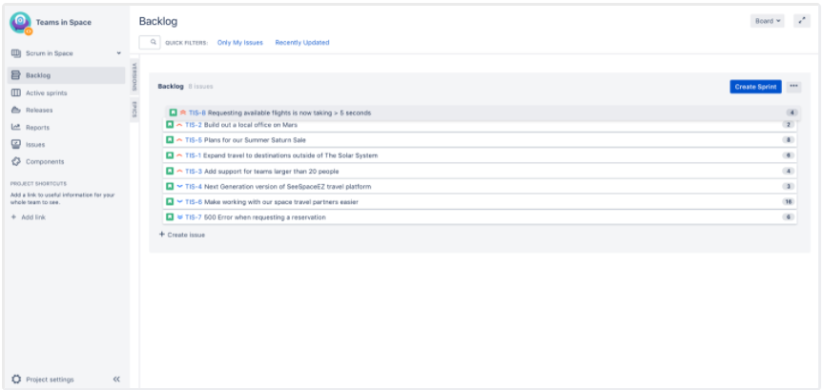
Jira – Grooming your Backlog
An essential part of agile is regularly "grooming" or reviewing the contents of your backlog, particularly before starting any new work
Adjust your backlog
Before starting your sprint, you need to prepare your backlog. You can easily adjust your backlog by:
  Right-clicking on issues to view, estimate, or add details
  Ranking your issues by dragging and dropping
  Creating new issues
  Editing an issue using the issue detail view

Slide 33
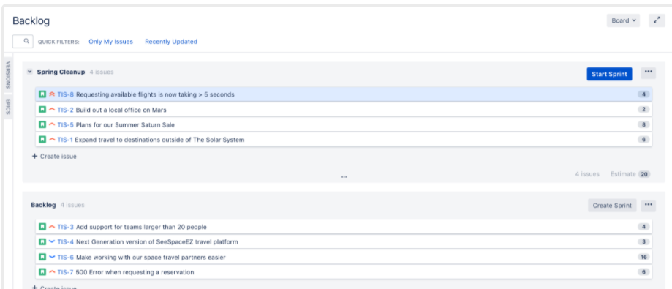
Jira – Planning your Sprint
Every sprint starts with a planning meeting. When planning a sprint, your team would typically commit to deliver a set of stories that are pulled from the top of the backlog. Before creating and starting a sprint, your Scrum team would typically hold a sprint planning meeting. In this meeting, your team should:
  Review the estimates for selected issues
  Break down the selected issues into an initial list of sprint tasks
  Consider upcoming employee time-off, holidays, and other issues that may impact the completion of these sprint tasks
  Gauge the team's capacity team to complete these sprint tasks
Once the sprint backlog is ready and upon the confirmation from Delivery lead, the sprint will be started in Jira on first day of build phase. A report will be generated that shows the number story planned for the sprint along with story points and shared with the relevant parties.

Slide 34
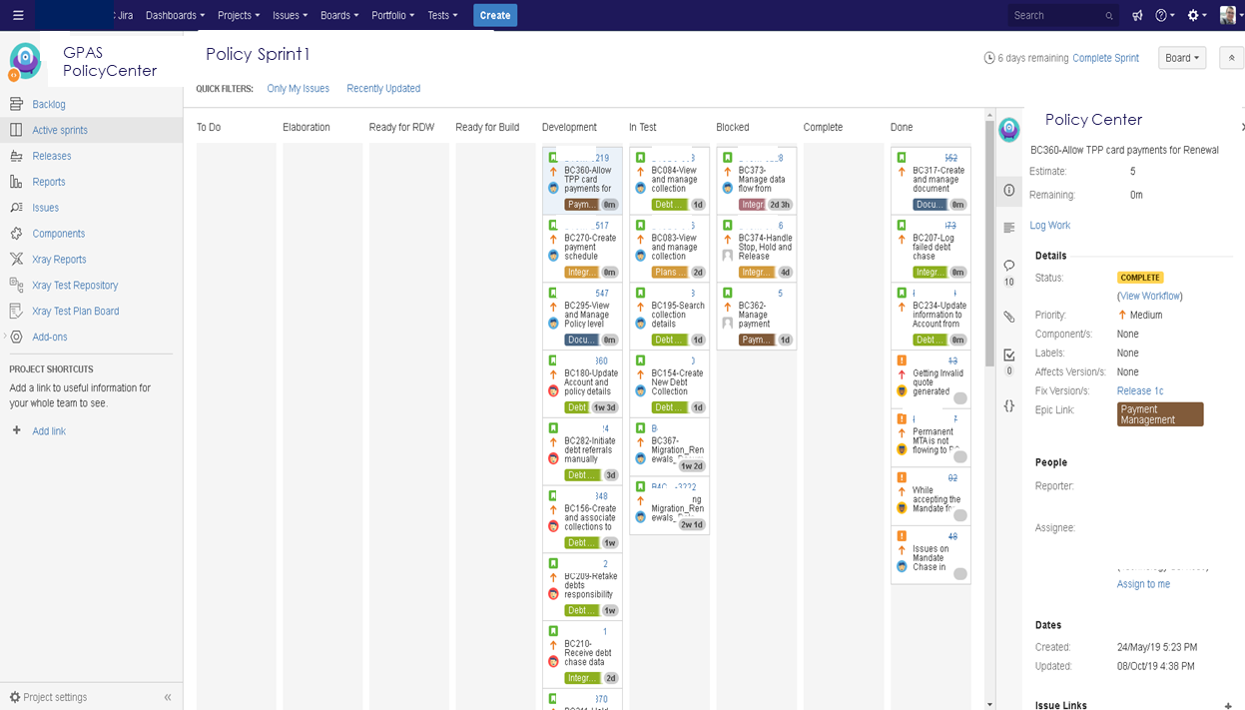
Jira – Active Sprint Overview
The Active sprint window is accessed via the main menu on the left (Either click the icon if the menu is collapsed, or click ‘Active Sprints’)
This screen shows a summary of the current sprint, along with the status of each user story.
This screen is organized into columns and swim lanes. Each o the columns represents a point in the workflow of a story. The workflow flows from left to right and it is possible to click and drag stories into the appropriate columns. Once the story reaches the ‘Done’ column it is regarded as complete.
If a user story has sub-tasks then a swim lane for that story is displayed. Each of the sub-tasks are moved from left to right in the same way as the stories. Once all sub-tasks are moved into the ‘Done’ Column then the story status is marked as done.

Slide 35
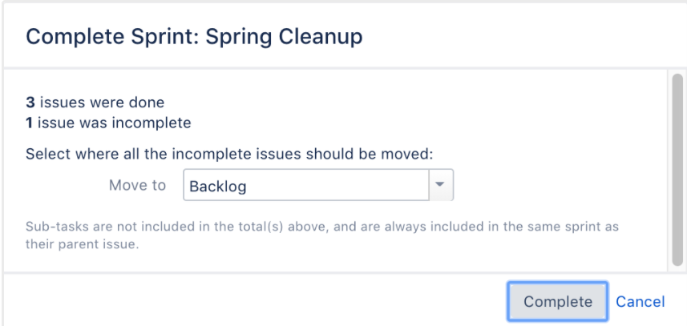
Jira – Completing a Sprint
The end of a sprint is usually the time where your team takes stock of its progress. This usually includes demonstrations of the work completed during the sprint, followed by a sprint retrospective to analyze where improvements can be made.
  Subtasks are moved to appropriate status for the completed stories
  User stories are moved to DONE statues for which Demo are completed & accepted
  Conduct Retrospective and link notes to the sprint
  Decision is made for the issues which are not in DONE status either to be deferred and moved back to backlog or to be moved to subsequent sprint upon sprint closure
On the last day of the sprint, once the above activities are completed then upon the confirmation from delivery lead, the sprint will be closed in Jira. The sprint report will be generated & shared with relevant parties.

Slide 36
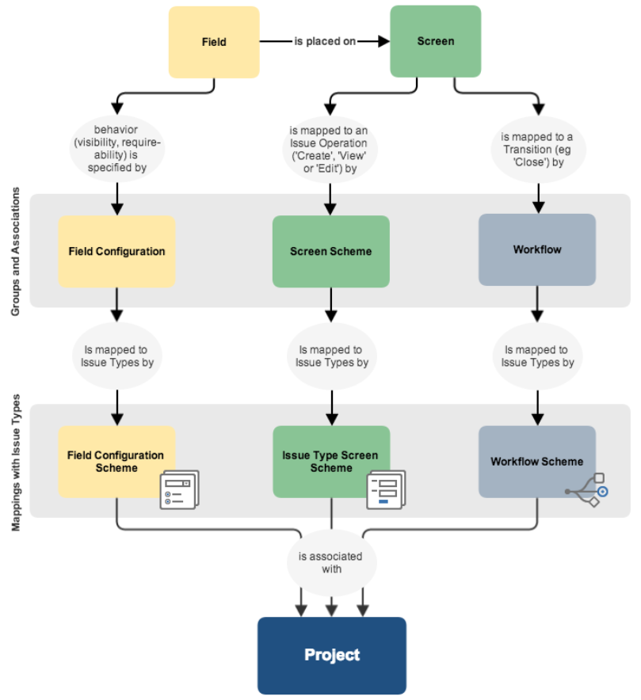
Jira Setup – Project Configuration
Below are few key configurations
New custom fields can be created and can be set as mandatory fields as required
User have an option to customize the fields to be displayed on a different screens (Create/View/Edit) for an issue type
Workflows can be associated with particular projects and optionally, specific issue types by using a workflow schema
Jira application allow a variety of permissions: from whether users can create new projects to delete an issue or specify a comment on an issue
Project role is a flexible way to associate users and/or groups with a particular project
Permissions
Roles
Notifications
Components

Slide 37
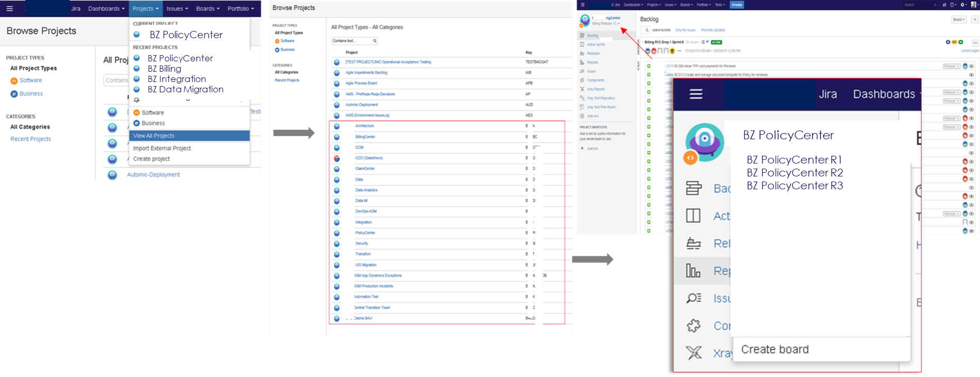
Jira Navigation – Project view
Go to Projects > View All Projects to view all projects in Jira -
When in a project, navigate between boards by going to the dropdown below the project name in the top left hand corner.

Slide 38
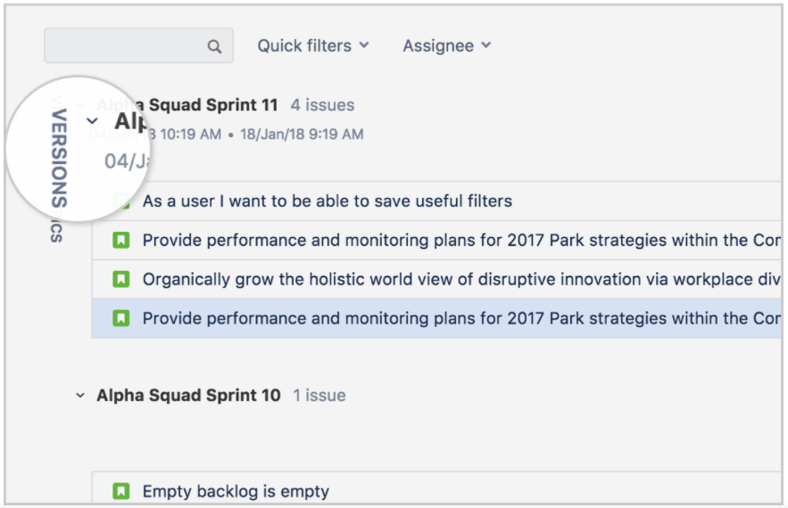
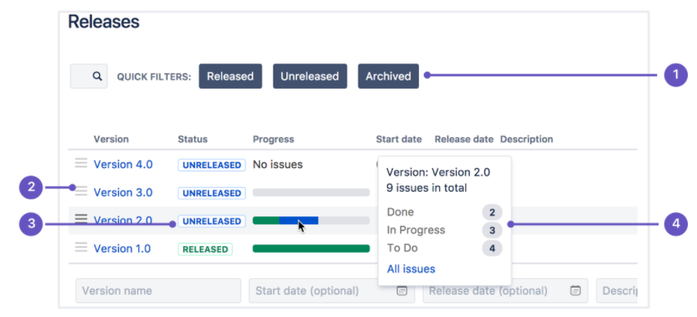
Jira Navigation – Version view
If project has backlog
Navigate to Project backlog
Open the versions panel on the left
Drag the issues to the version you want to add it to.
Or
Open the issue you want to add to a version
Find the Fix version/s field, and enter the version you want to add the issue to
Go the Project, the select Release from project menu
Quick Filter – Focus on specific versions by filtering out the ones you aren’t interested in.
Version List – Drag & Drop version to reorder them
Status – Versions can have one of the three statuses. Unreleased, Released, or Archived
Progress – This shows how many issues have been assigned to the version, and how many are in each status.

Slide 39
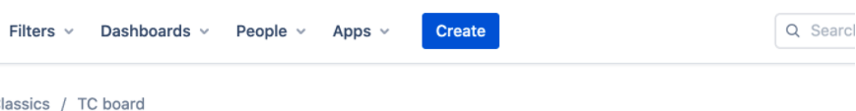
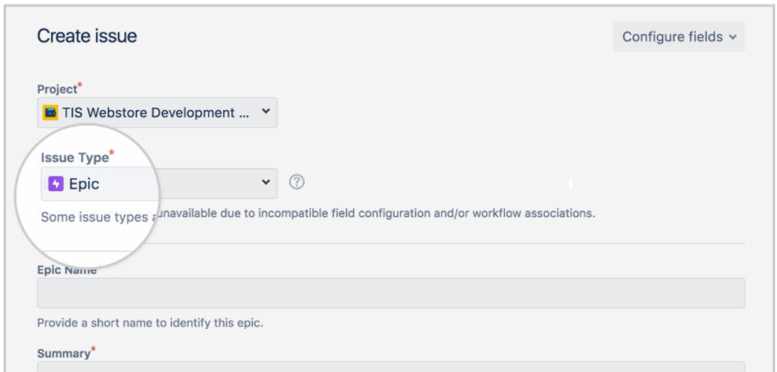
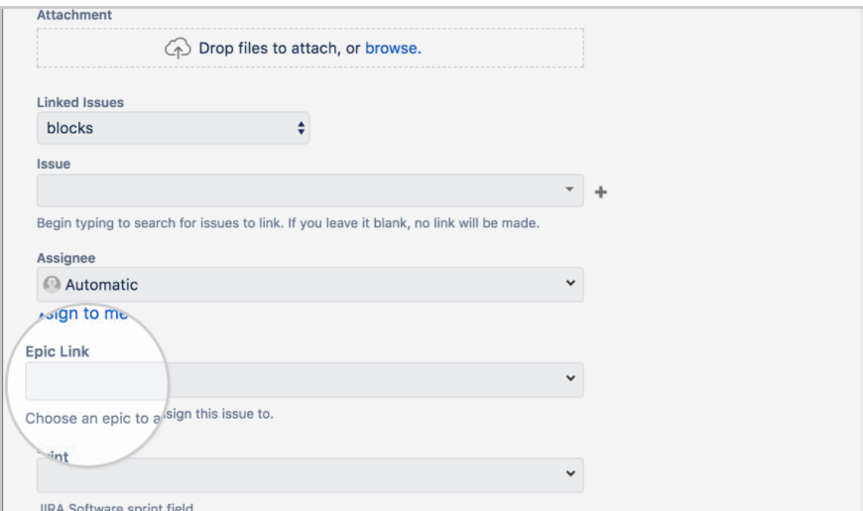
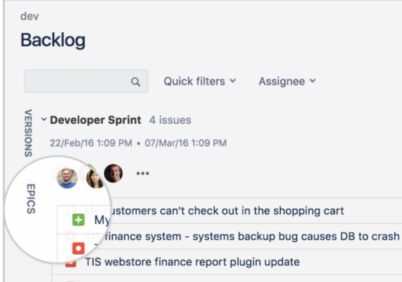
Issue Creation - Epic
1
Click the create button located in the global navigation bar at the top of the screen.
Select Epic for the issue type.
Navigate to the Backlog & Click on the Epics Panel.
Open a Story card and update Epic Link field
2
4
3

Slide 40
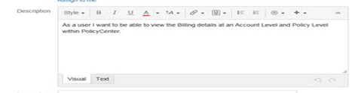
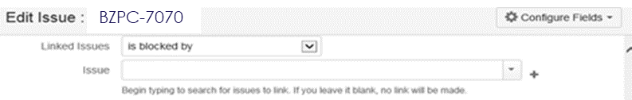
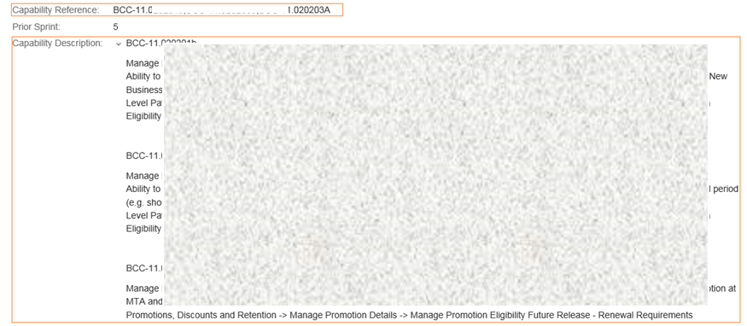
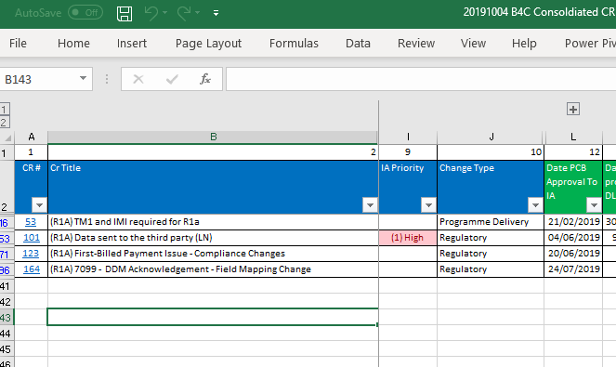
Issue Creation – User Story
Mandatory fields in GENERAL tab
Summary
Description
Functional requirement captured in Gerkin format (As a…I want to…)
Entry criteria, Exit criteria
Non-functional / performance consideration (if any)
Integration consideration (if any)
Data migration requirements (if any)
Linked Issue
Dependent or impacted user story (across streams)
Link ‘Dependency’ issue type for external or internal data, integration or other dependencies of the user story
Link ‘Pre-Condition’ issue type for any pre-requisites
Related open defect (if any)
Acceptance Criteria
Given <a scenario>, When <I do something>, Then <a result occurs>
Capability Reference
Capabillity Description
Fix version
Sprint
Story Points
Work Stream (stream that develops the user story)
Business Priority
Backlog

Slide 41
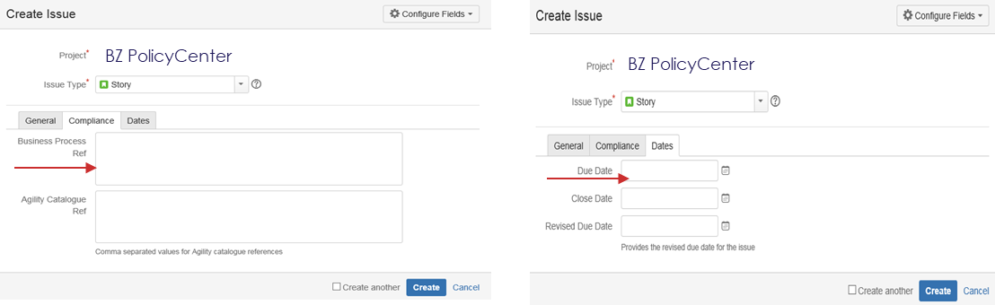
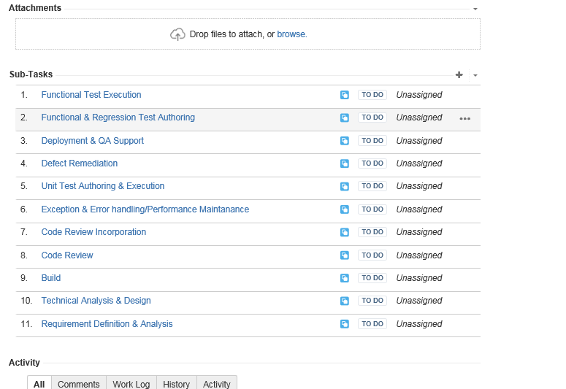
Issue Creation – User Story
Mandatory inputs in Compliance tab
Update Busineess Process Ref with:
Design Phase Deck: <Sharepoint link>
MOCK UP: <Sharepoint link>
FLOW: <Sharepoint link>
BUSINESS RULES DOCUMENT (BRs, UWIs): <Sharepoint link>
FLS: <Sharepoint link>
ACTIVITY PATTERN CATALOGUE:
HISTORY EVENTS:
TYPELIST MASTER:
Inputs in Date tab
Planned due date to be updated by Scrum team during during Design phase workshop (story grooming)

Slide 42
Issue Creation – Sub-tasks for each Story (auto-created in Jira) - TBD
Standard sub-tasks will be auto created for user story. Scrum team may add additional tasks as needed to ensure effective task allocation and effort tracking of all Scrum team members.
Effort needs to be logged at sub-task level by the Scrum team
All sub-tasks need to be DONE before story can be marked as DONE
Standard sub-tasks (auto-created) for story | No. of tasks per User Story | Activity owned by | Deliverable | Description
Requirement Definition & Analysis | 1 to many | BA | N/A | Effort required to define the user story in compliance with Definition of Ready
Technical Analysis & Design | 1 | Dev | Yes | Effort required for technical analysis and design
Build | 1 to many | Dev | N/A | Effort required to develop the story (code, integration, data) Exceptions & Alerts closed Code review feedback incorporated Effort required for deployment and supporting QA in test data preparation
Code Review | 1 | Dev | Code review document | Development Standards have been met (Coding & Guardrails) UI/UX guidelines have been met Ensure code review comments are closed and code review document updated with closure status
Unit Test Authoring & Execution | 1 | Dev | Unit test results | Contains all the unit test sets to be used for unit testing the functionality of the newly built system
Defect Remediation | 1 | Dev | N/A | Effort to fix defects raised during Sprint
Functional Test Authoring | 1 to many | QA | Functional and Regression test set | Effort required for test authoring and test data preparation
Functional Test Execution | 1 to many | QA | QA Report | Effort required for test execution Confirm successful test execution and upload of QA report

Slide 43
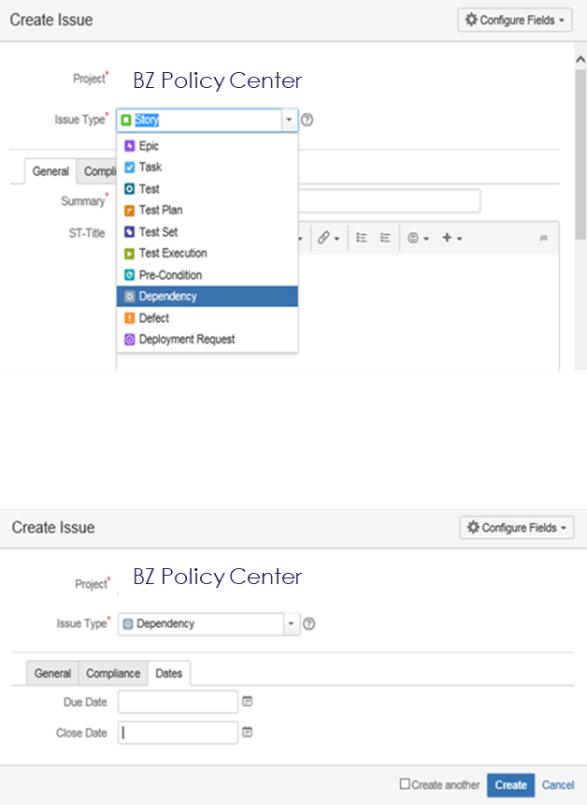
Issue Creation – Dependency
Mandatory fields in GENERAL tab
Summary
Assignee (point of contact responsible for getting closure on dependency resolution)
Description
Linked Issue
Impacted or dependent user story
Impacted or dependent defect
Impacted or dependent tests
Priority
Fix Version (version in which dependency is deployed)
Acceptance Criteria
Given <a scenario>, When <I do something>, Then <a result occurs>
Sprint
Work Stream (stream impacted by the dependency)
Inputs in Date tab
Planned due date to be updated by Scrum team

Slide 44
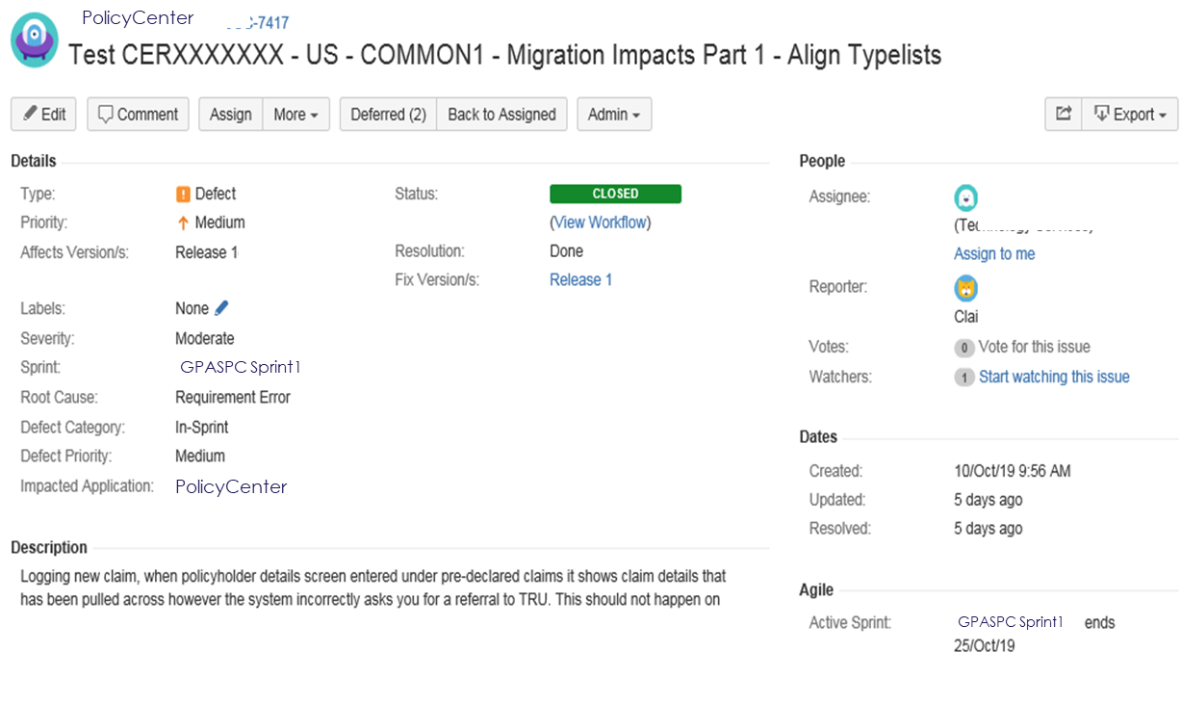
Issue Creation – Defect
Mandatory fields in GENERAL tab
Summary
Reporter
Description
Fix Version
Affects Version
Severity
Environment (dropdown of environment in which
Assignee (Product Owner)
9. Linked Issue
Impacted and dependent user story
Impacted and dependent test case
10. Defect Priority
11. Root Cause
12. Sprint
13. Defect Type
14. Defect Category
15. Impacted Application
16. Work Stream (stream in which defect is identified)

Slide 45
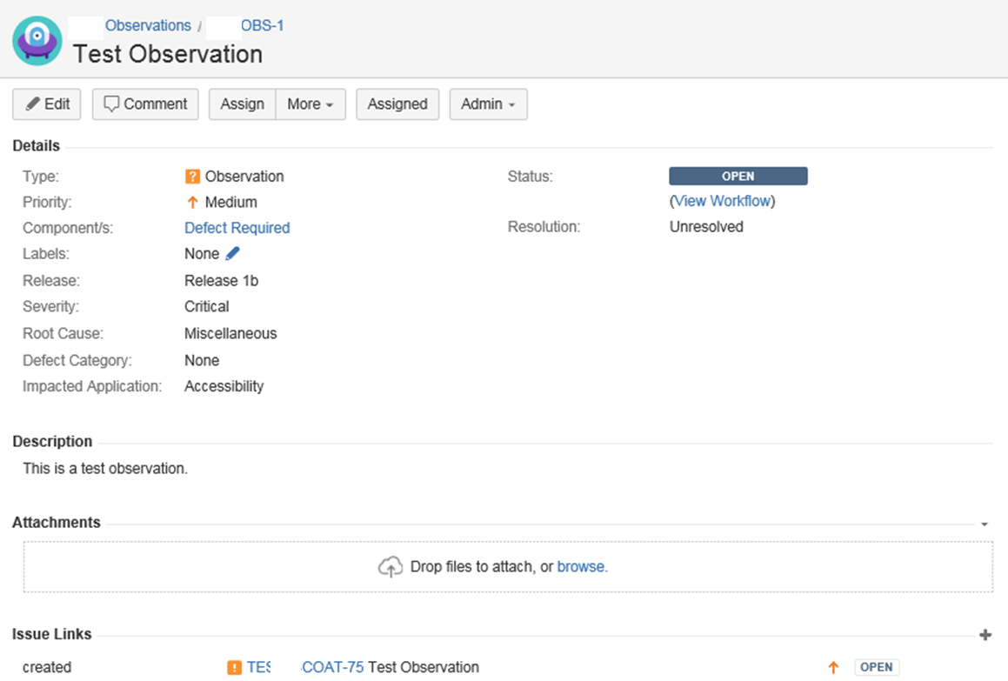
Issue Creation – Observation
Functional gap or defect that do not conform to requirement description or acceptance criteria stated in the user story will be logged as an Observation
Mandatory fields in GENERAL tab
Summary
Description
Assignee (Product Owner)
Release (Release in which observation is identified)
Business priority
Severity
Linked Issue
Impacted and dependent user story
Impacted and dependent defect
Root Cause
Impacted Application
Work Stream (stream in which observation is identified)

Slide 46
Thank you!

